Slide 1
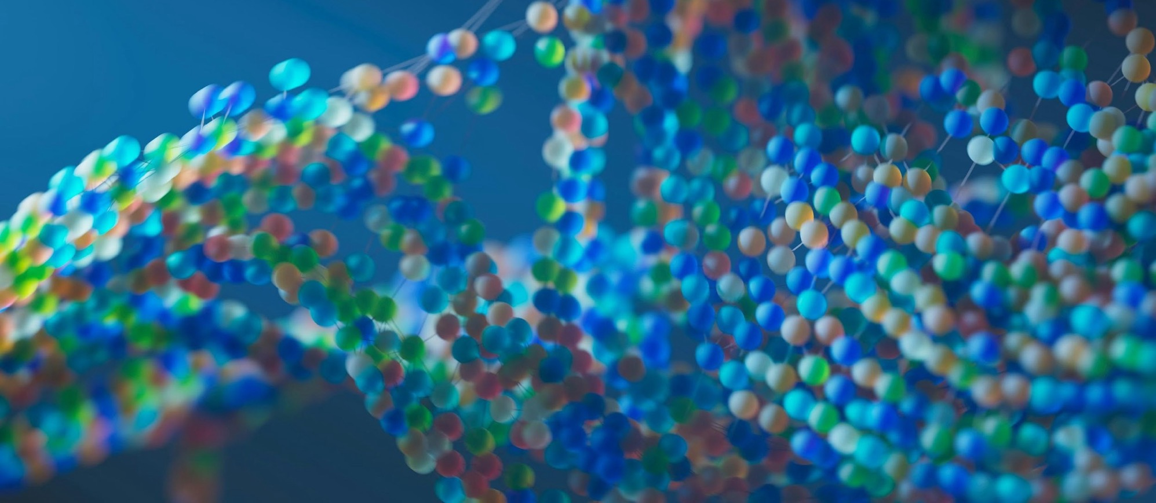
CMU Portugal
Advanced Training Program
Natural Language Processing and Computer Vision
JOÃO MAGALHÃES
NOVA SCHOOL OF SCIENCE AND TECHNOLOGY
VASCO RAMOS
NOVA SCHOOL OF SCIENCE AND TECHNOLOGY
BRUNO MARTINS
INSTITUTO SUPERIOR TÉCNICO

Slide 2




Computer Vision​: What? Why?
Area of CS that focuses on how computers process images.
Focus on emulating human vision in the real world!
But featuring with strong connections to medical imaging, remote sensing, document understanding, …
Many practical applications (face recognition, self-driving cars, photography, etc.).
How can we design vision encoders?
How can we use vision encoders for image classification and object detection?

Slide 3
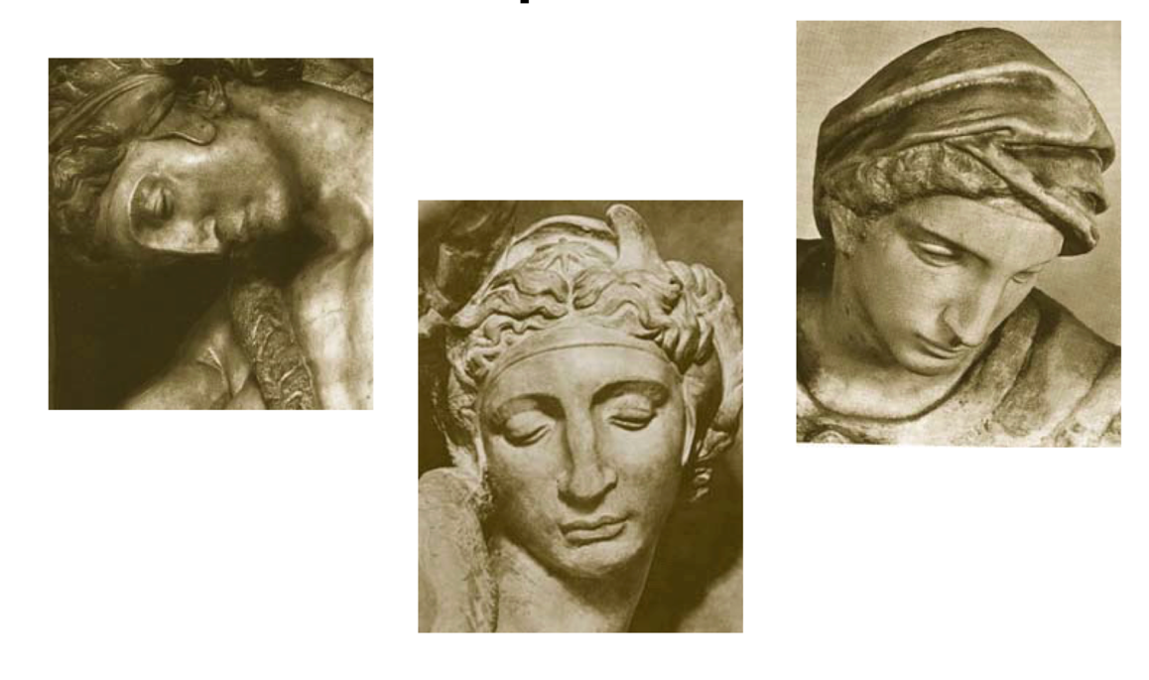
Is it Really so Hard? Yes, due to variable viewpoints!

Slide 4
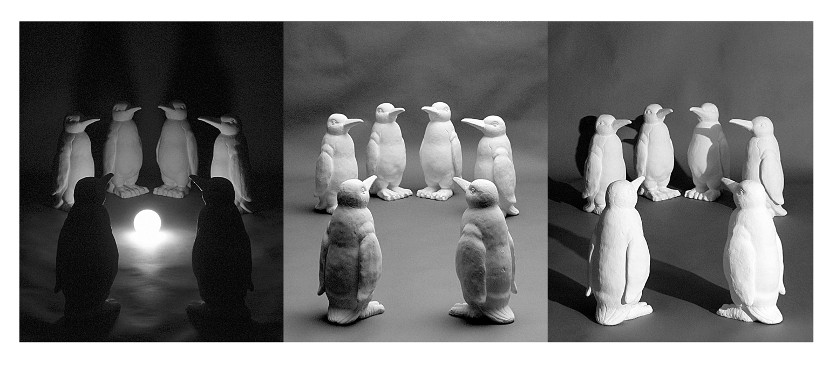
Is it Really so Hard? Yes, due to variable illumination!

Slide 5
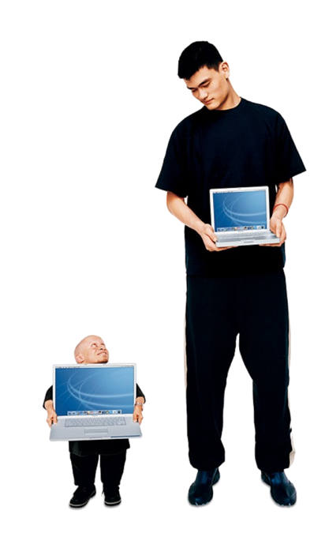
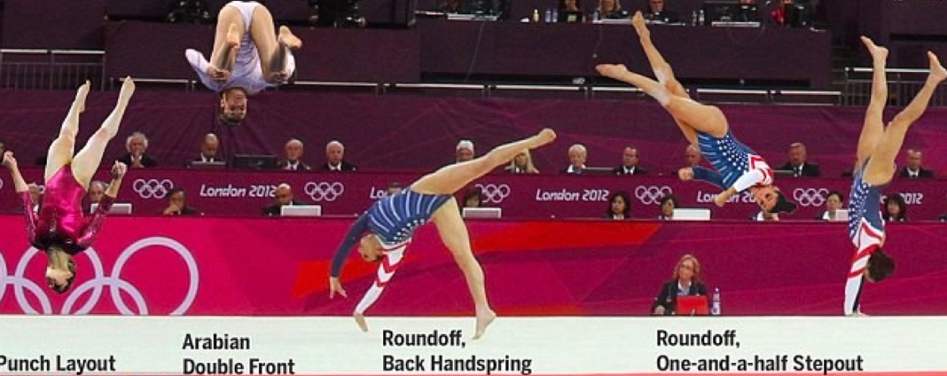
Is it Really so Hard? Yes, dealing with scale and pose!

Slide 6

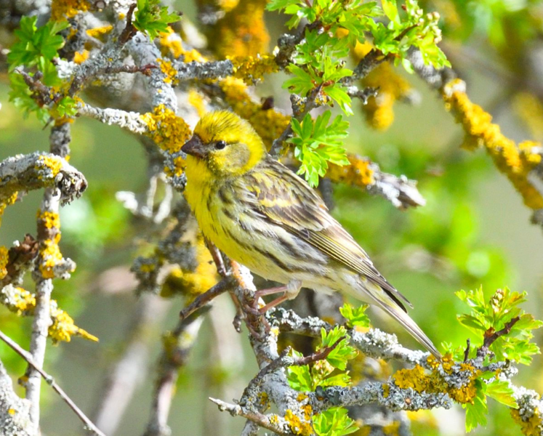
Is it Really so Hard? Yes, occlusions and background clutter!

Slide 7
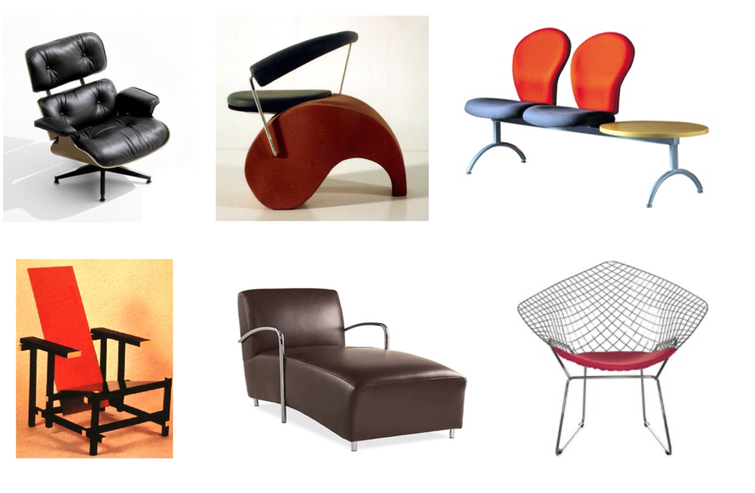
Is it Really so Hard? Yes, due to intra-class variations!

Slide 8
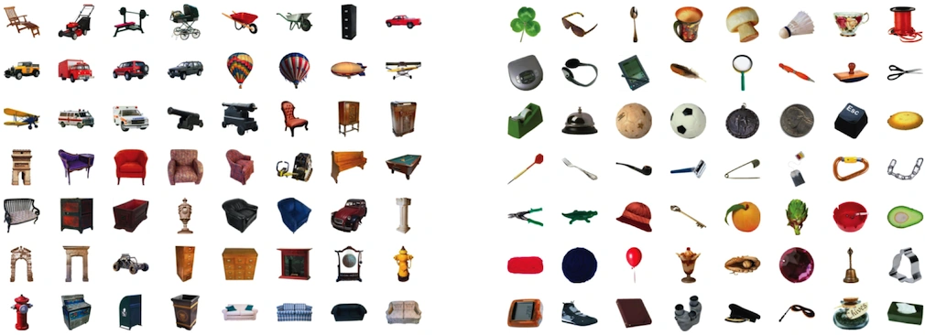
Is it Really so Hard? Yes, there are lots of potential classes!

Slide 9
Image Representations (i.e., descriptive features)
Importantly, the area deals with the construction of compact representations that describe the visual contents of images.
Global image representations:
A high-dimensional vector, a.k.a. an embedding.
But can also be multiple local features:
Histograms of edges, colors, or gradients.
A set of regions of interest and their features.

Slide 10
What can we do with Image Representations?
Classification:
Given a set of classes/labels and an unseen image, classify the image.
Object detection and segmentation:
Delimit the region of the image that depicts a given object.
Use multiple features, usually from a set of regions.
Search and cross-modal applications:
Search for similar images according to their representations.
Search for images matching a textual description (can also be used for open-domain classification)
Image captioning, visual question answering, etc.
To be covered in the next lecture.

Slide 11
Learning Image Representations and Classifiers
Use a dataset to learn the parameters of a model that gives you both image representations and a classifier.
Given the model and classifier, predict the label for a new image.
Which model to use?
Deep convolutional neural networks.
Transformer encoders.
Main lesson from recent years: It is much better to learn representations, instead of designing "hand-crafted" features!

Slide 12
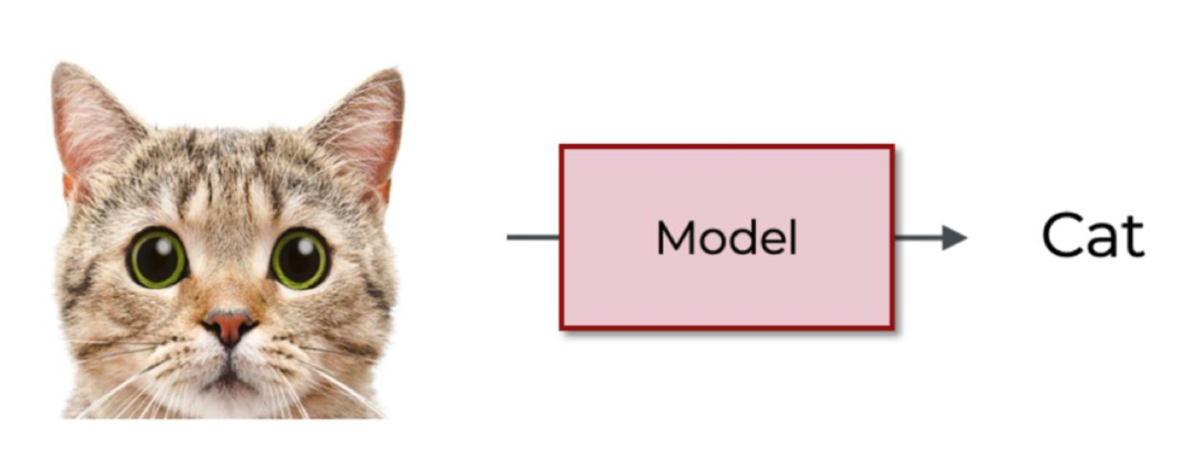
Image Classification
Given a set of classes/labels and an unseen image, classify the image.

Slide 13
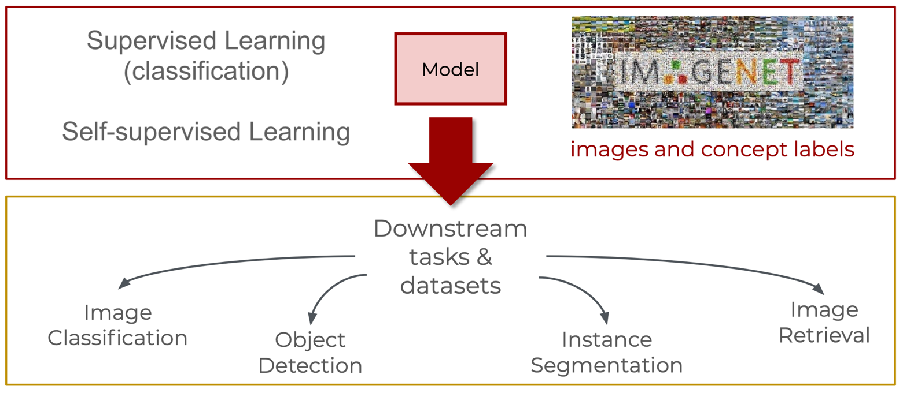
Learning General Purpose Representations

Slide 14
Datasets Used by the Community
CIFAR-10 [2009]:
60000 32x32 color images in 10 classes (6000 images per class).
ImageNet [2010 – current]:
Huge, crowdsourced, hierarchical, iconic objects.
COCO (Common Objects in Context) [2014 – current]:
Crowdsourced, large-scale objects, different types of annotations.
LAION 5B [2022 – current]:
5.85 billion noisy image-text pairs from the Web.

Slide 15
Self-supervised versus Supervised Training
Supervised: Use a labeled dataset to learn the parameters of a model that gives you both image representations and a classifier.
Self-supervised: Use large scale image data to align augmented views (e.g., distillation as in DINO and DINOv2) or reconstruct image regions (e.g., MIM/MAE models).
Training with Language Supervision: Train the image encoder so as to align the representations to text representations, or to reconstruct the text from the image representations.

Slide 16
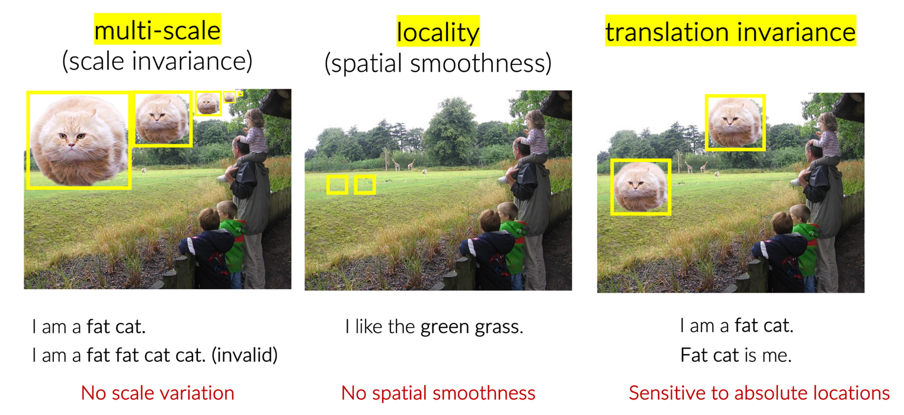
Key Differences Between Visual and Textual Inputs

Slide 17
Overview
Introduction
Convolutional Neural Networks
Vision Transformers
Object Detection, Segmentation, and other Tasks
Exercises

Slide 18
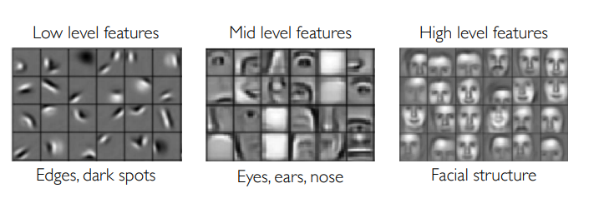
Convolutional Neural Networks (CNNs)
Inspiration from visual cortex in mammal brains.
Deep neural networks in which each layer uses the representations of the previous layer to learn higher level abstractions.
Pixels → Edges → Contours → Object parts → Object categories.
Local Features → Global Features.

Slide 19
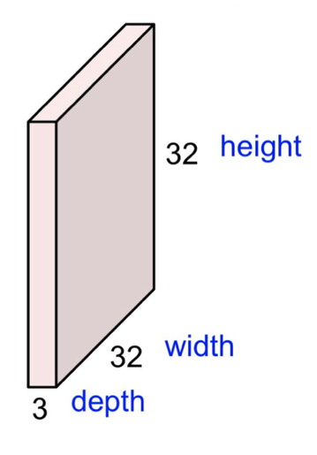
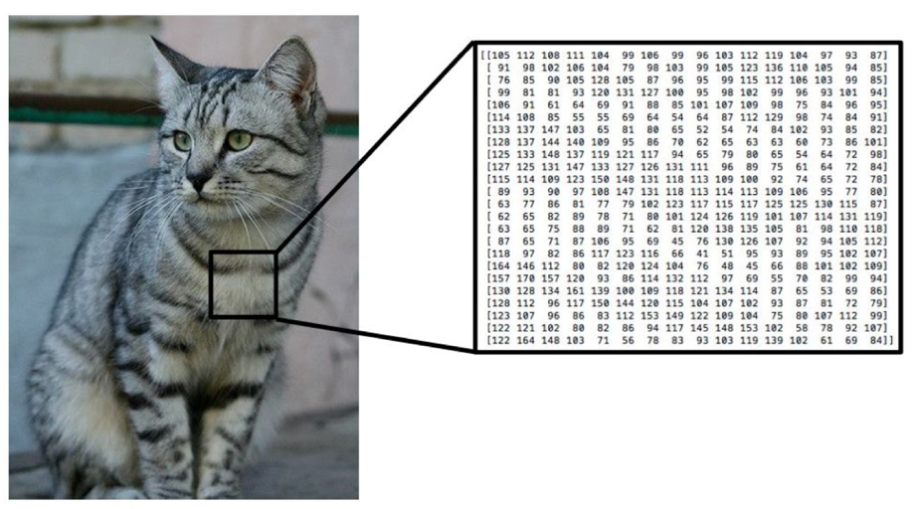
Images are Represented as Pixel Intensities
Data tensor of normalized RGB pixel values.

Slide 20
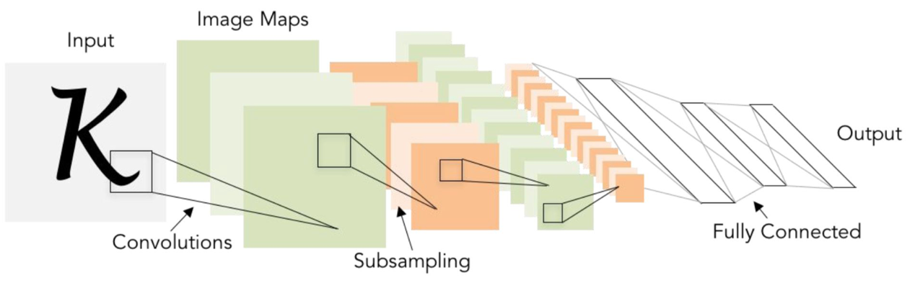
Basic Components of CNNs
Final fully connected layer.
Convolutional layers.
Activation functions (non-linearities).
Subsampling/pooling layers.
Residual connections.

Slide 21
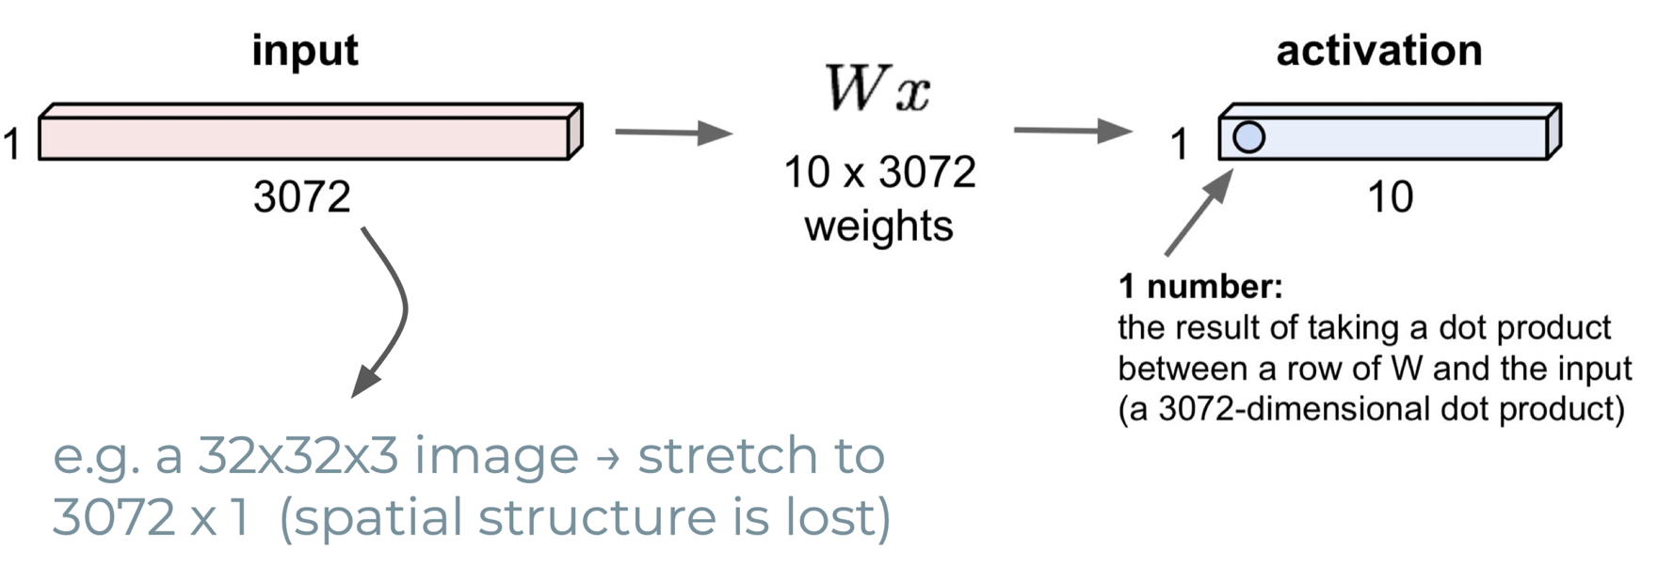
Fully Connected Layer

Slide 22
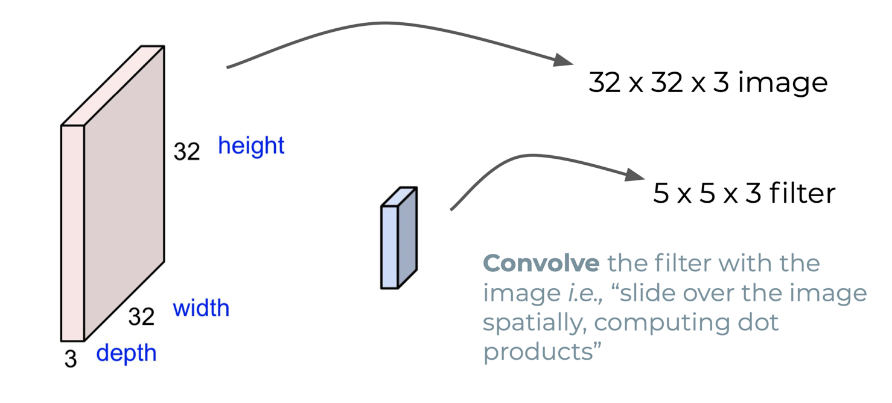
Convolutional Layers (1)

Slide 23
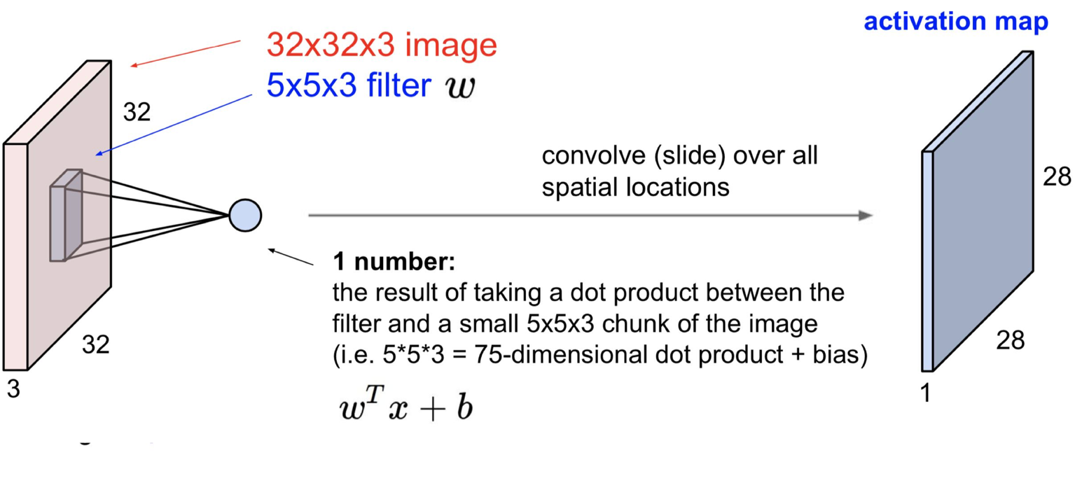
Convolutional Layers (2)

Slide 24
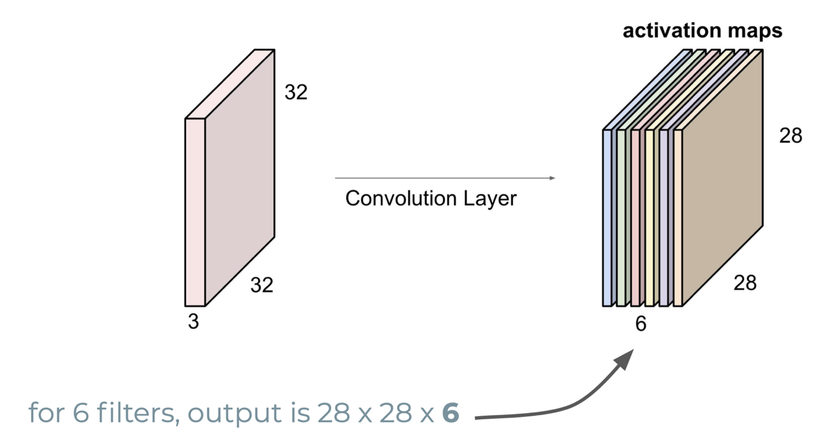
Convolutional Layers (3)

Slide 25
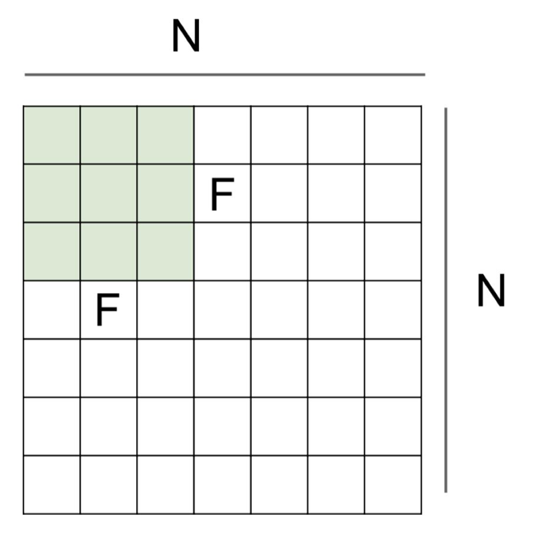

Convolutional Layers - Stride
Output Size: ((N-F) / stride) + 1.
For instance, with N=7, F=3:
With stride=1, (7-3)/1+1=5.
With stride=2, (7-3)/2+1=3.
…

Slide 26
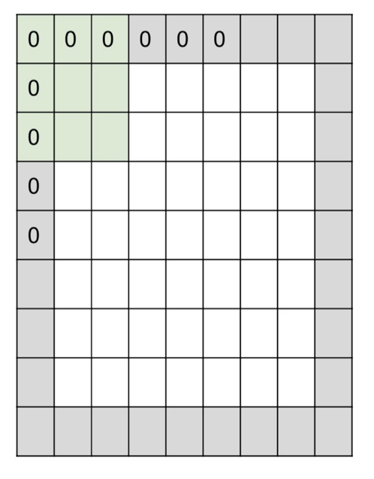
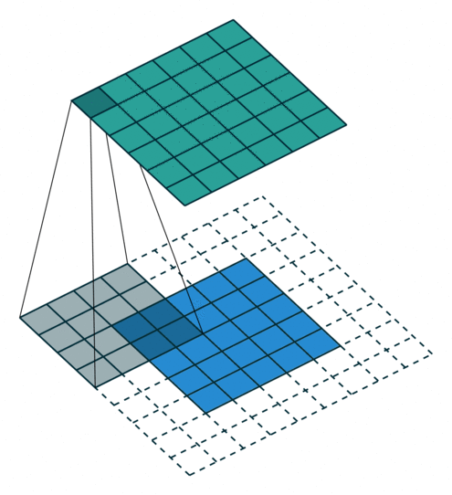
Convolutional Layers - Padding
Input size: 7x7.
Convolution filter of 3x3.
Stride = 1.
Pad with 1 pixel border.
Output size: 7x7.

Slide 27
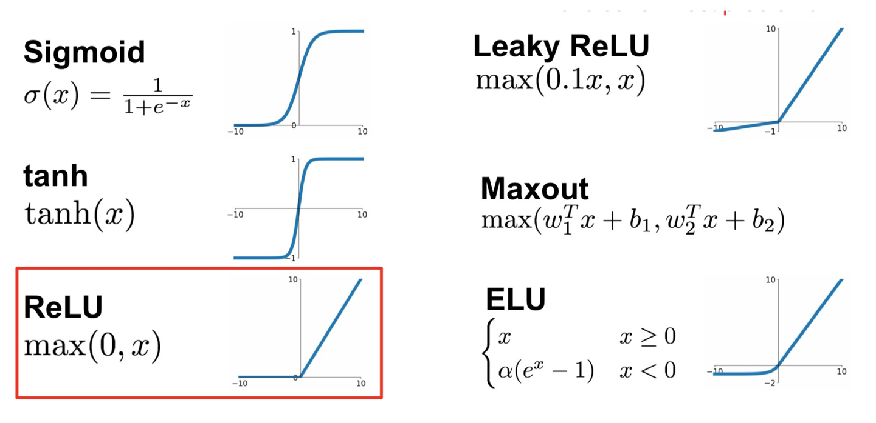
Activation Functions

Slide 28
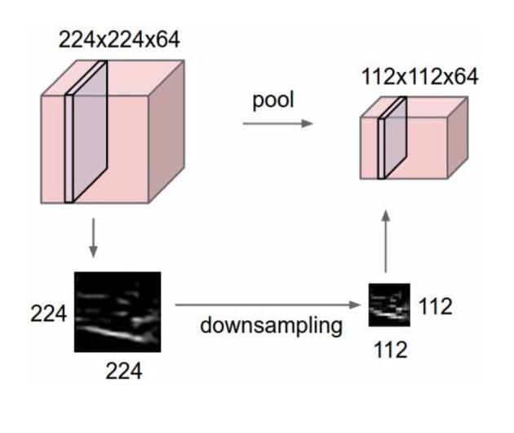
Subsampling/Downsampling Layers
Operate on each activation map independently.
Reduce input dimensionality.
Does not involve learnable parameters.
Typical pooling functions:
Max.
Average.

Slide 29
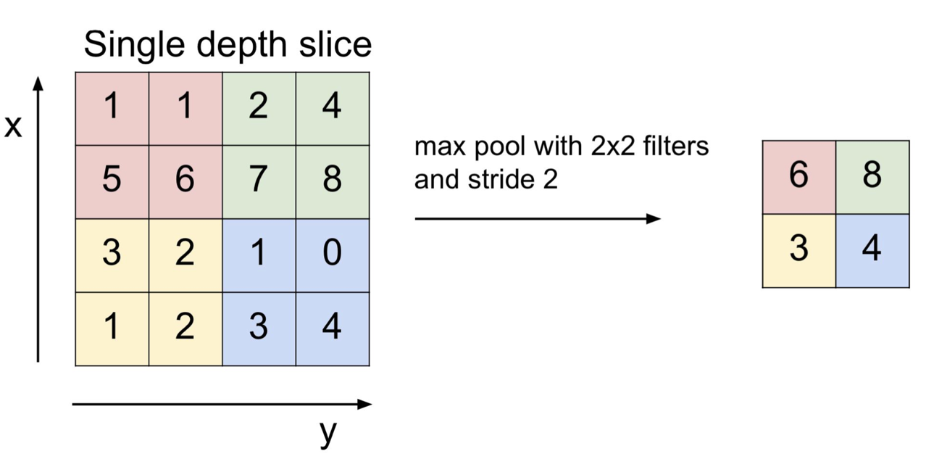
Maxpooling Layers

Slide 30
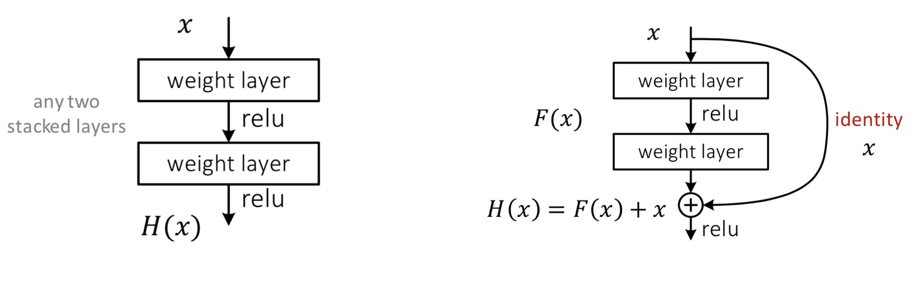
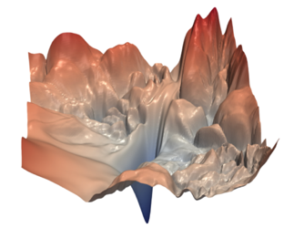
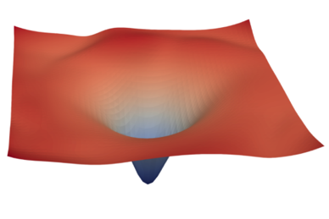
Residual Connections (e.g., used in ResNet CNNs)

Slide 31
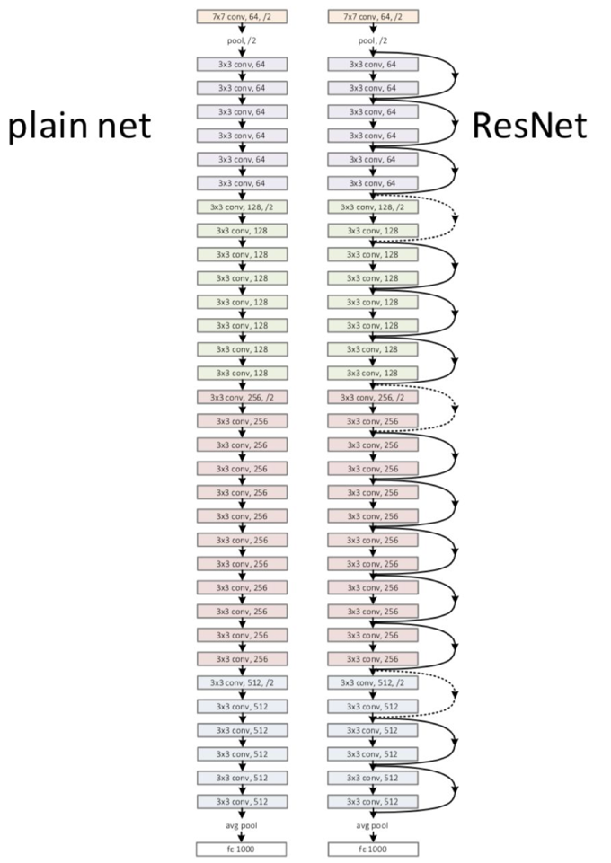
Putting it all Together!
ResNet – simple and elegant design.
All 3 x 3 convolutions.
Spatial size / 2 ⇒ # filters x 2.
Same complexity per layer.
Global average pooling + fully connected.
A very common image encoder!
He, et al. Deep Residual Learning for Image Recognition. CVPR 2016.

Slide 32


Exercise Time
https://pytorch.org/hub/pytorch_vision_resnet/

Slide 33
Overview
Introduction
Convolutional Neural Networks
Vision Transformers
Object Detection, Segmentation, and other Tasks
Exercises

Slide 34
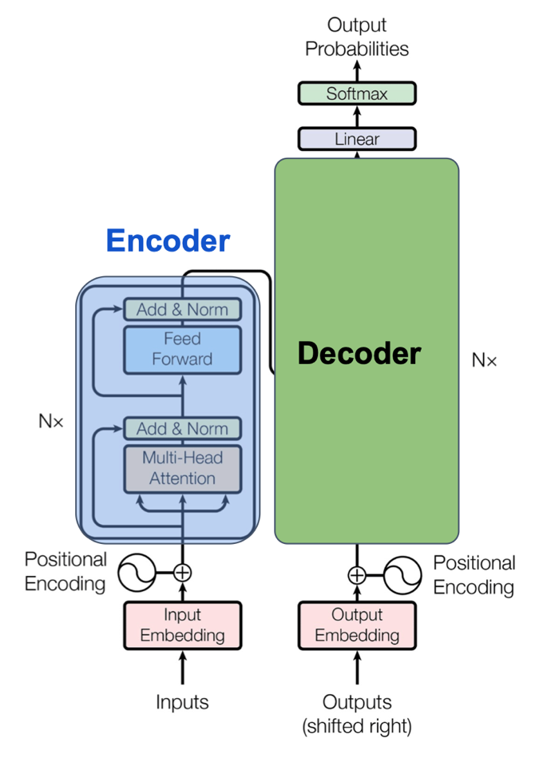
The Transformer Encoder
Self-attention supports strong feature extracting/enhancing modules.
Advantages for computer vision:
Long-range interaction via attention.
Performance/scalability with large scale data.
Some limitations:
Quadratic computational complexity.
Lacking locality (to some degree).
Lacking low-level details due to large patch sizes.

Slide 35
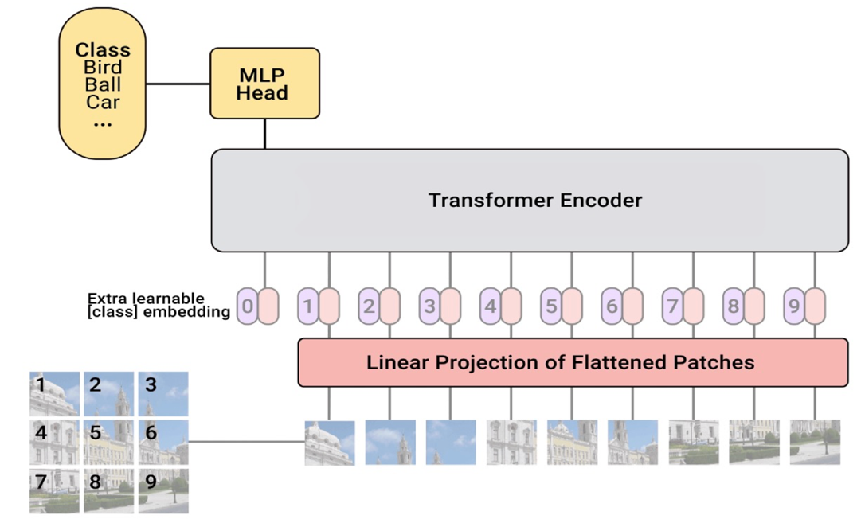
Vision Transformers (ViTs)
Dosovitskiy, et al. An image is worth 16x16 words: Transformers for image recognition at scale. ICLR 2021.

Slide 36
Overview on the Vision Transformer
Divide input image into 196 (14x14) small patches of size (16x16).
Flatten each image patch and treat it as an embedding in NLP.
Add one special element to sequence of patches and use the sequence as input to a traditional transformer encoder (like in BERT).
Use 12 transformer layers (with normalization, multi-head attention, etc.).
Take the first position of the last output, use it as input for feed-forward layer with 1000 classes (e.g., ImageNet classification).
You have an image classification model!

Slide 37
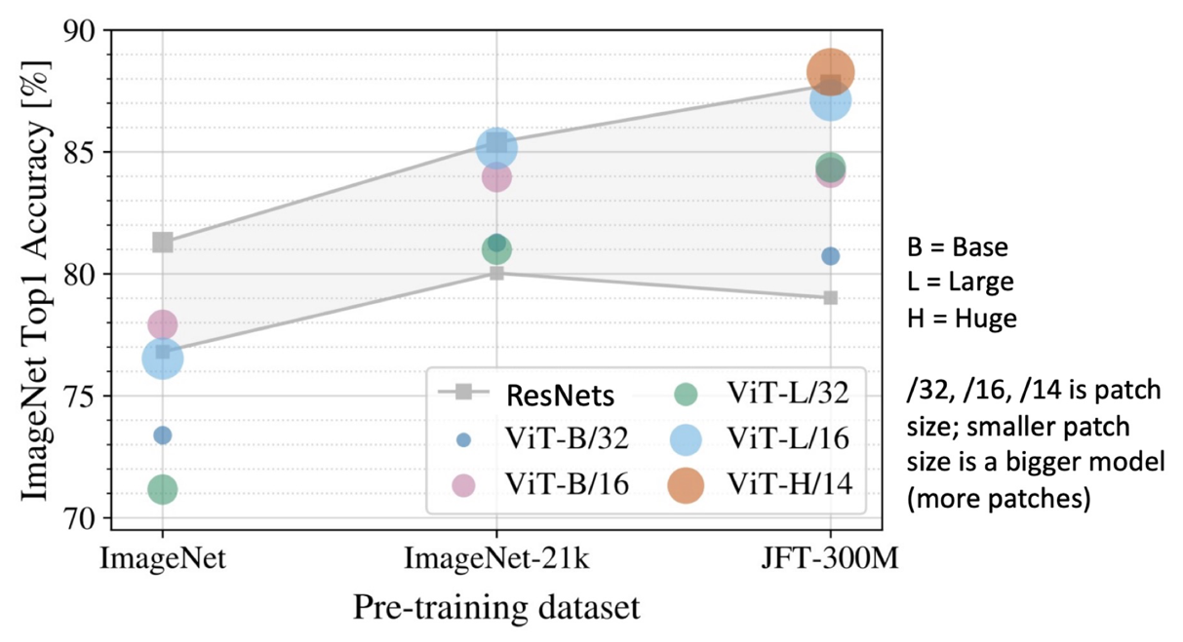
Performance of ViTs versus CNNs
JFT-300M is an internal Google dataset with 300M labeled images.
If you pre-train on JFT-300M and fine-tune on ImageNet, large ViTs outperform CNNs!

Slide 38
Key Differences Between Visual and Textual Inputs

Slide 39
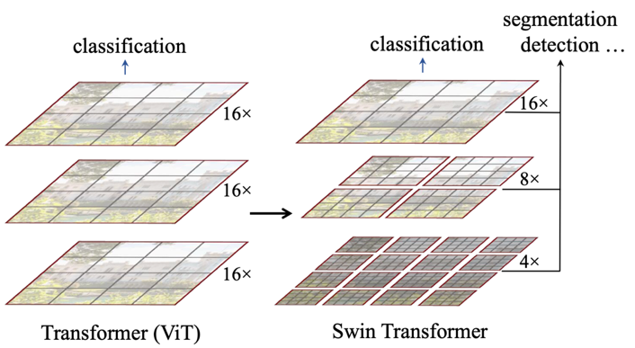
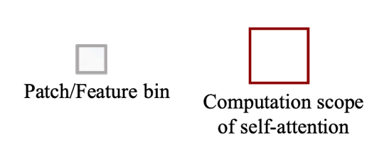
Hierarchical Vision Transformers
SWIN Transformer: Hierarchical vision transformer using shifted windows.
Multi-scale (hierarchical) feature map.
Use (shifted) windows to get image patches for multi-head self attention.
More friendly to visual signals (multi-scale / locality / translation invariance).

Slide 40
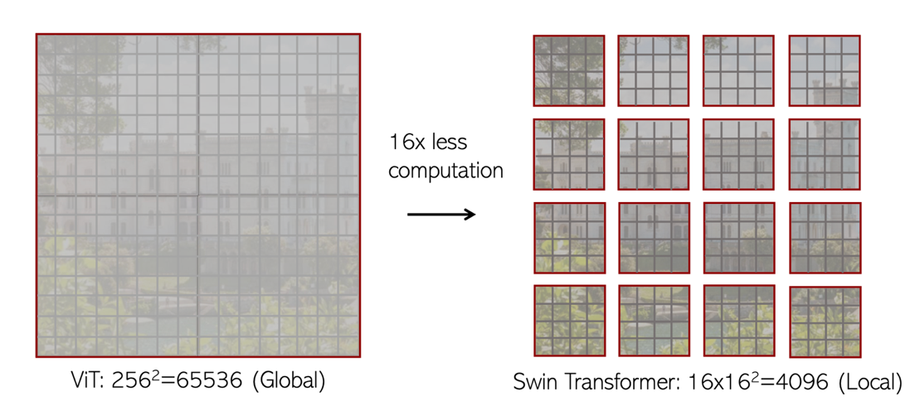
Locality by Non-Overlapped Windows
Proves beneficial in modeling the high correlation in visual signals.
W-MSA has linear complexity with increasing image resolution: from O(n²) to O(n).

Slide 41
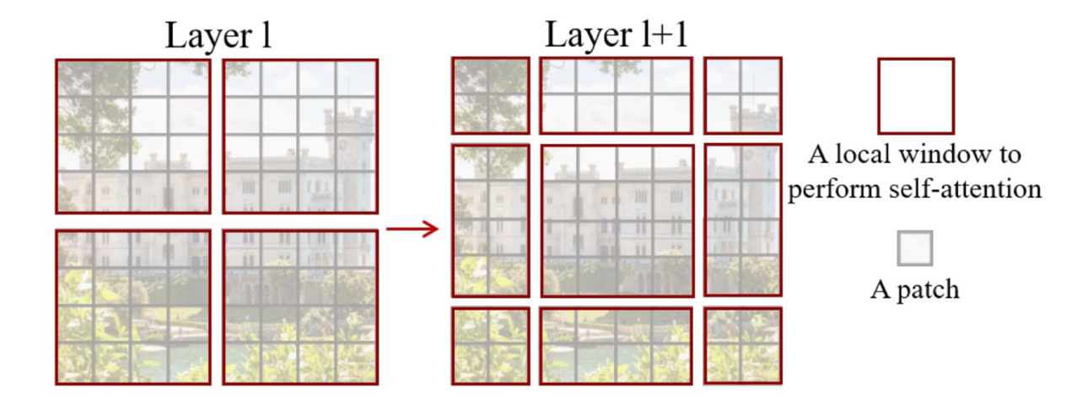
Shifted Non-Overlapped Windows
Non-overlapped windows will result in no connections between windows.
Shifting in SW-MSA enables cross-window connections.

Slide 42
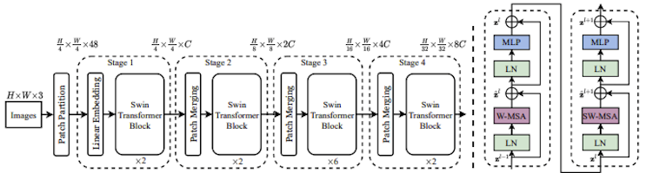
The SWIN Architecture

Slide 43
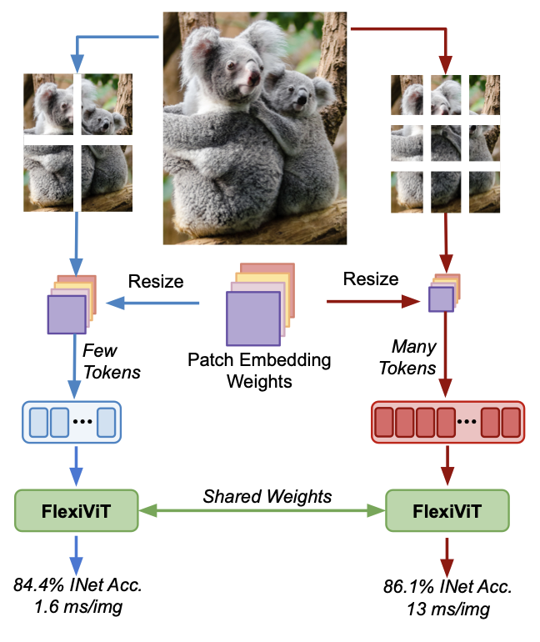
Many Other Recent Architectural Developments
FlexiViT: Use randomized patch sizes, i.e. different sequence lengths, with the patch embedding weights being resized adaptively.
Pix2Struct: Alternative patching which preserves the aspect ratio.
NaViT: Pack multiple patches, from different images/resolutions, into a single sequence for training, while preserving the aspect ratio.
MaxViT: Combine local blocks and sparse global interactions to achieve linear complexity while retaining global context.
Performer / Linformer / X‑ViT: Approximate attention, with random sampling or low‑rank factorization, to achieve near‑linear complexity.
…many options aiming at the efficient processing of high-resolution images…

Slide 44
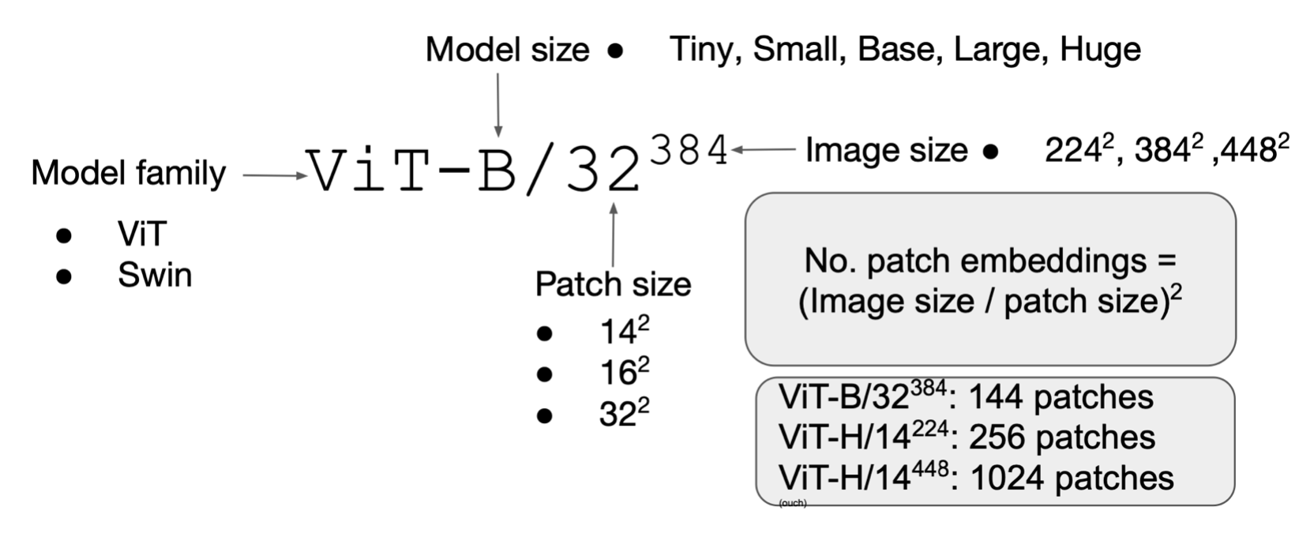
Nomenclature and Patch Count

Slide 45
Exercise Time
https://huggingface.co/docs/transformers/tasks/image_classification

Slide 46
Overview
Introduction
Convolutional Neural Networks
Vision Transformers
Object Detection, Segmentation, and other Tasks
Exercises

Slide 47
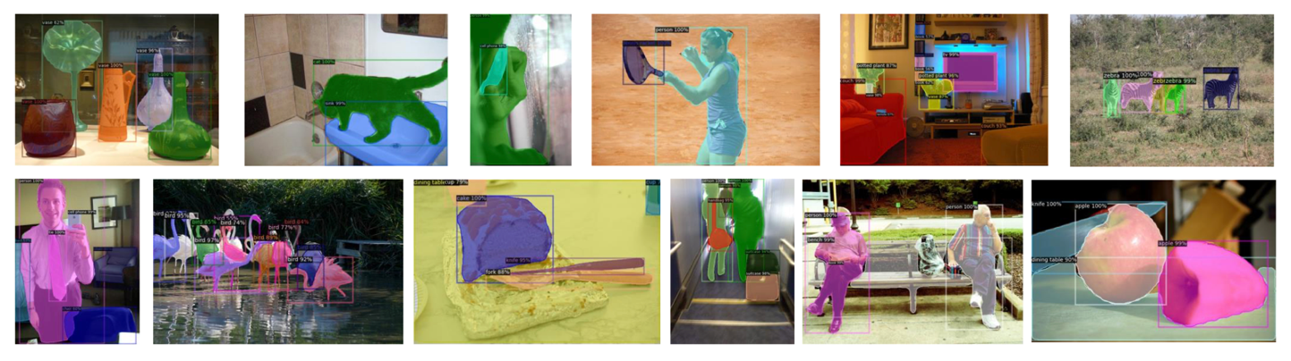
Object Detection and Segmentation
Besides classification, other common computer vision tasks involve identifying and localizing objects:
Location of the object (XY coordinates of the bounding box, or per-pixel mask).
Class of the object.

Slide 48
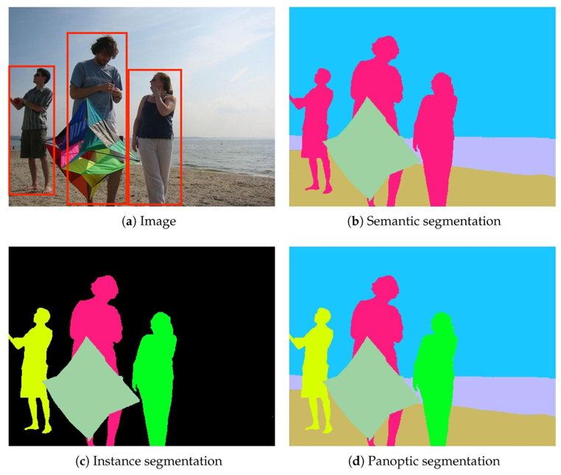
Different Types of Tasks
Detection
Closed vs. open vocabulary.
Standard vs. rotated bounding boxes.
Referring expressions.
Segmentation:
Semantic.
Instance (i.e., things).
Panoptic (i.e., things plus stuff)
Referring expressions.

Slide 49
Models for Object Detection and Segmentation
Common pipeline with Transformers:
Image feature extraction through a backbone.
Feature enhancement through transformer encoder.
Learnable object queries aggregate pixel features through transformer decoder (cross-attention).
The decoder produces box/mask embeddings, which inform predictions.
Specialized loss functions (e.g., based on bipartite matching).

Slide 50
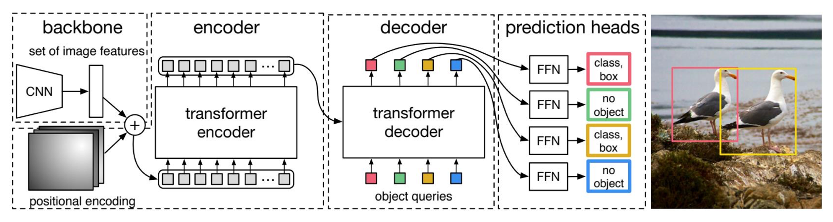
The Detection TRansformer (DeTR)
Nicolas Carion et al. End-to-End Object Detection with Transformers. ECCV 2020.

Slide 51
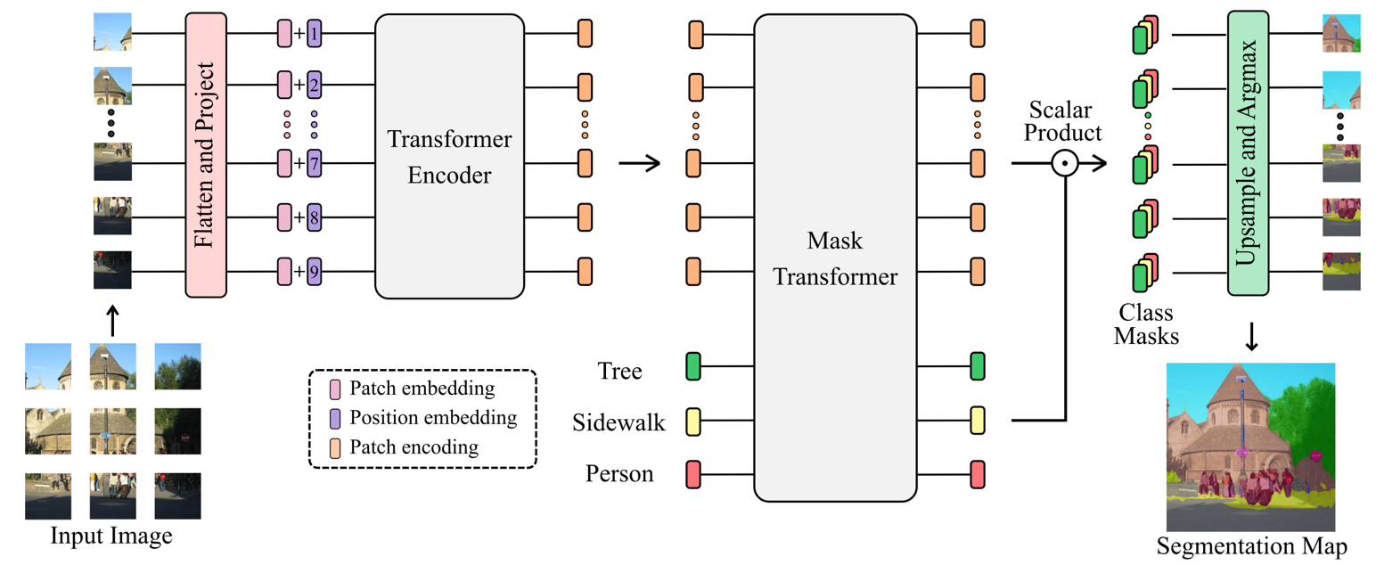
Segmenter
Robin Strudel et al. Segmenter: Transformer for Semantic Segmentation. ICCV 2021.

Slide 52
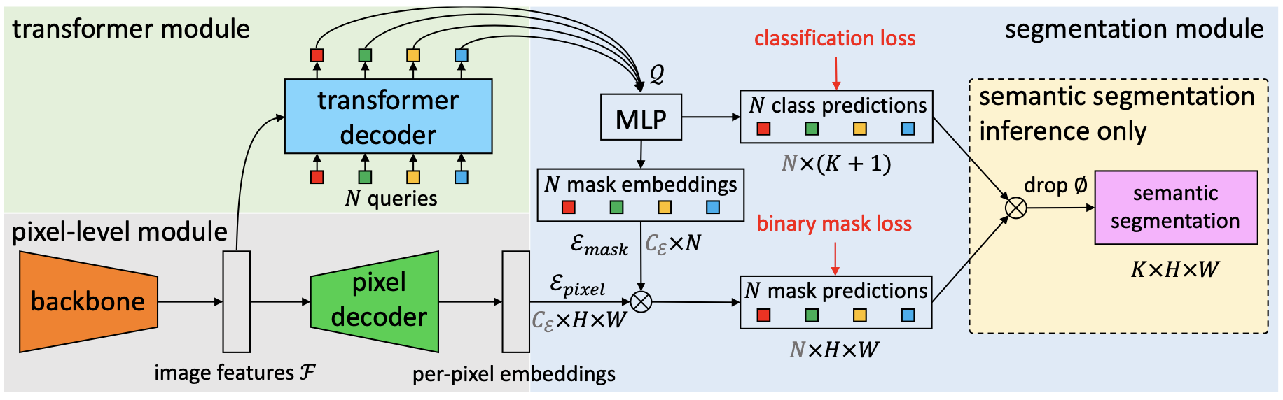
MaskFormer
Bowen Cheng et al. Per-Pixel Classification is Not All You Need for Semantic Segmentation. NeurIPS 2021.

Slide 53
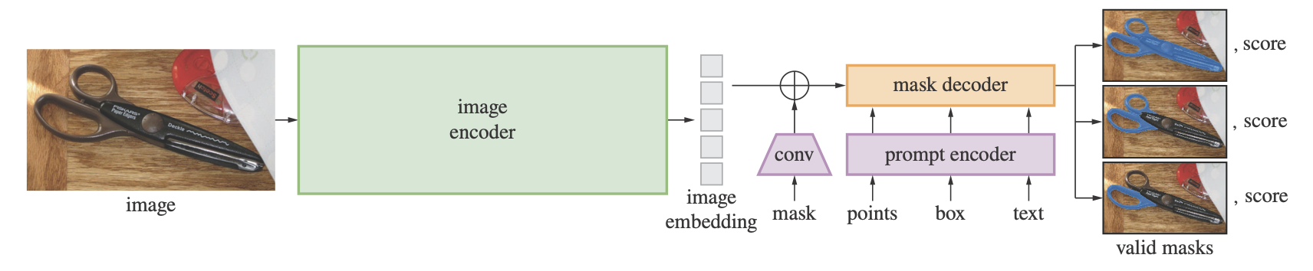
Segment Anything Model (SAM and SAM2)
Kirillov et al. Segment Anything. arXiv:2304.02643 2023.

Slide 54
Conclusions
We overviewed modern computer vision techniques.
Deep neural networks for computing image representations
Inform downstream tasks like classification, detection, or segmentation.
Encoder models based on CNNs or Transformers.
Tradeoffs associated to both types of models.

Slide 55
Exercise Time
https://huggingface.co/docs/transformers/tasks/object_detection
https://huggingface.co/docs/transformers/tasks/semantic_segmentation

Slide 56
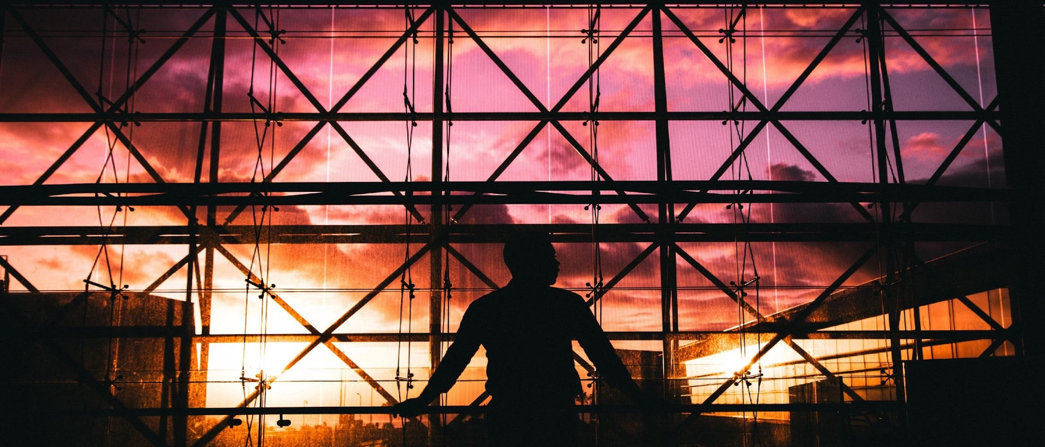
Thank you!

